Slide 1

SMART MIRROR using raspberry pi
By NAVEEN KUMAR B

Slide 2
ABSTRACT
In today’s society, information is available to us at a glance through our phones, our laptops, our desktops, and more. But an extra level of interaction is required in order to access the information. As technology grows, technology should grow further and further away from the traditional style of interaction with devices. In the past, information was relayed through paper, then through computers, and in today’s day and age, through our phones and multiple other mediums. Technology should become more integrated into our lives - more seamless and more invisible. We hope to push the envelope further, into the future. We propose a new simple way of connecting with your morning newspaper. We present our idea, the Smart Mirror information at a glance. Our system aims to deliver your information quickly and comfortably, with a new modern aesthetic. While modern appliances require input through modules such as keyboards or touch screen, we hope to follow a model that can function purely on voice and gesture. We seek to deliver your information during your morning routine and throughout the day, when taking out your phone is not always possible. This will cater to a larger audience base, as the average consumer nowadays hopes to accomplish tasks with minimal active interaction with their adopted technology. This idea has many future applications, such as integration with new virtual or augmented reality devices, or simplifying consumer personal media sources

Slide 3
INTRODUCTION
A smart mirror is a two-way mirror with an electronic display behind the glass. The display can show the viewer different kinds of information in the form of widgets, such as weather, time, date, and news updates

Slide 4
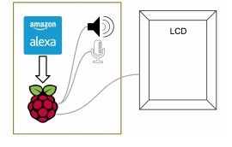
SYSTEM SPECIFICATIONS HARDWARE DESIGN
On the outside, the hardware is encapsulated within a IR Touch frame. On the front, a two-way mirror is placed in front of a LCD monitor. This way, the system can act as a mirror when not currently in use, while the LCD projects through the mirror when in use. The IR Touch frame has a bezel on the front which the mirror and LCD panel are pressed against. Inside Behind the LCD panel is the heart of the product, the Raspberry Pi, which is connected to the LCD for visual display. We also have a microphone and speaker attached for audio input and output. The Raspberry Pi runs our software and also allows us to connect to the Internet for web services, such as Amazon’s Alexa Voice Service
REQUIREMENT’S
>Raspberry Pi 3B+
>IR Touch Frame
>LCD Monitor
>Cable’s

Slide 5
SOFTWARE DESIGN
The goal of our project is to create an open platform for development, and all software components must fit to that goal. The software is designed to run on many platforms and fit many display types.
Operating system : Raspbian OS
Language : python

Slide 6
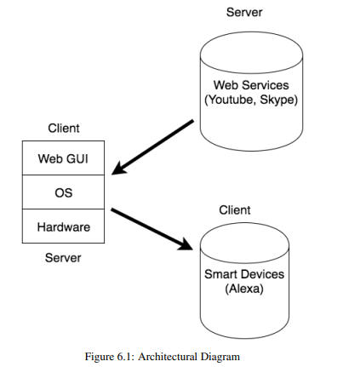
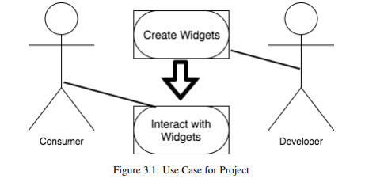
>ARCHITECTURE DIAGRAM
>USECASE
DIAGRAM

Slide 7
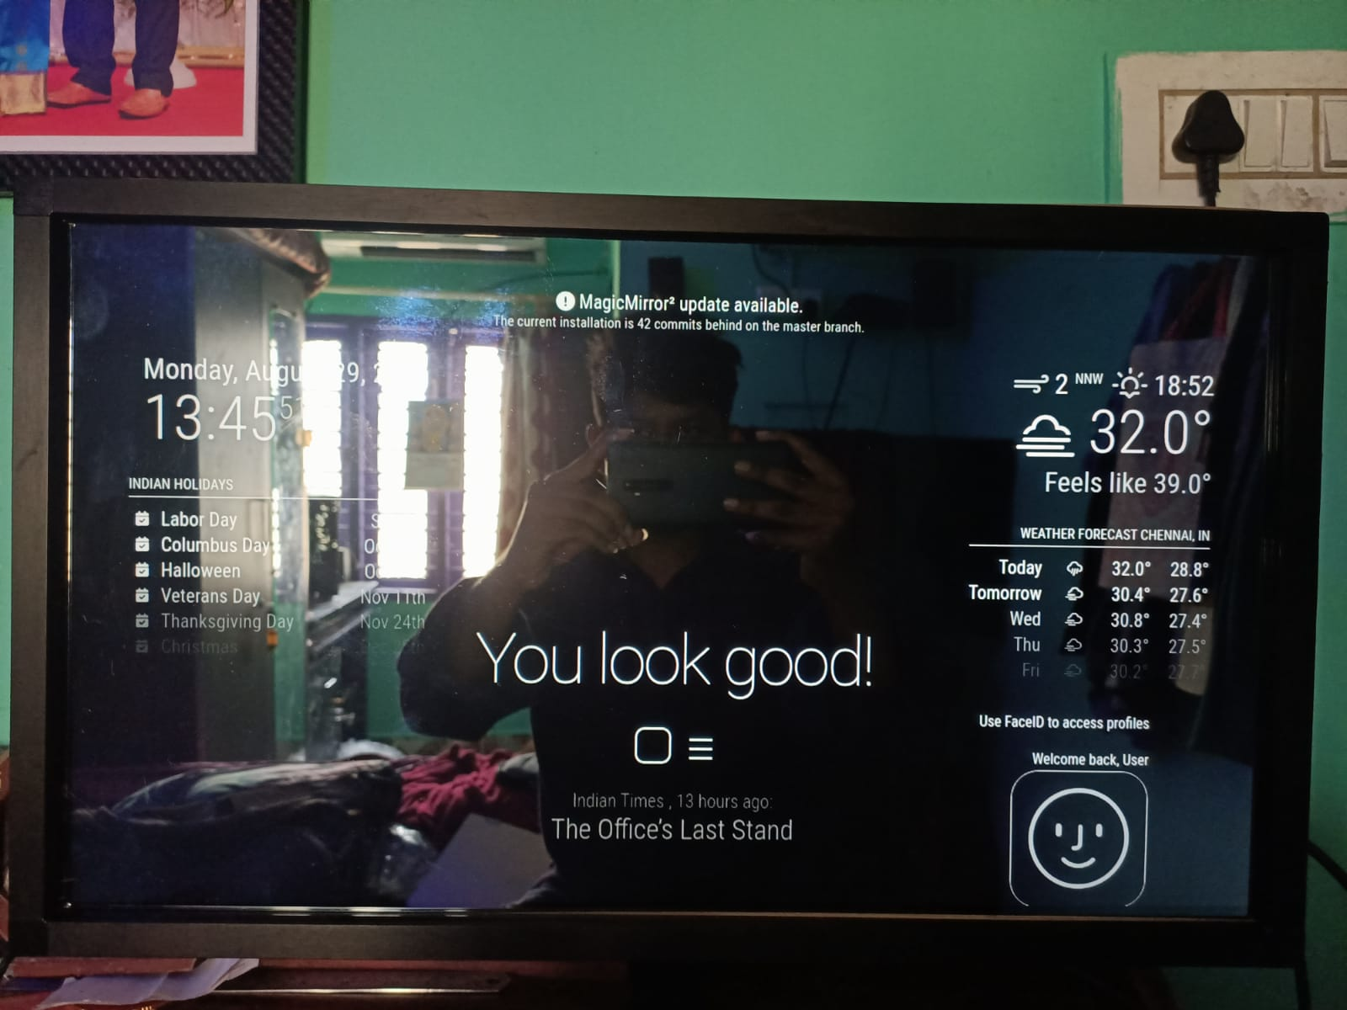
OUTPUT SAMPLE IMAGE
>CONCLUSION
☺Our finished product, as shown above, is demonstrated on our mirror hardware model. The hardware is simple, and elegant enough to demonstrate our widget structure. Our real focus was towards the design of our overall widget class structure. Our final project has a few demonstrations of the widget class, such as the weather widget and the RSS feeder, face recognition and touch feature, ect.
FUTURE ENHANCEMENT
Smart Virtual Mirrors :
Smart Virtual Mirror measures the user's body dimensions and shows 3D virtual fitting and draping simulation in real-time through two different fitting modes

Slide 8


